Slide 1
In the name of ALLAH the beneficent the merciful

Slide 2
Noman Haleem
B.E. in Textile Engineering from National Textile University
Specialization in Yarn Manufacturing
Topic
“Determination of Twist per Inch value in Double Yarns using Digital Image Processing Techniques”

Slide 3
Determination of twist per inch value in doubled yarns using digital image processing techniques By, Noman Haleem

Slide 4
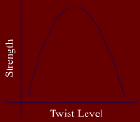
TPI value and its significance
Affects on yarn properties
Yarn strength
Yarn comfort
Moisture absorbency
Affects on fabrics
Dye uptake
Affects on garments serviceability
Abrasion
Pilling
Aesthetics affects

Slide 5
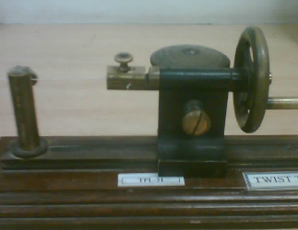
Conventional Methods of TPI determination
Manual Testers
Automatic testers
Direct counting methods
Twist untwist method
Take up twist tester
Conventional TPI tester

Slide 6
Limitations of the conventional methods
Destructive nature of testing
Offline testing modes
Slow speed of testing
Manual calculation
Human error
Machine performance and calibrations

Slide 7
Image processing
The analysis of a picture using techniques that can identify shades, colors and relationships that cannot be perceived by the human eye. Image processing is used to solve identification problems, such as in forensic medicine or in creating weather maps from satellite pictures. It deals with images in bitmapped graphics format that have been scanned in or captured with digital cameras

Slide 8
Image processing and textiles
Image processing is already being used in various branches of textiles for technical measurements and properties evaluation.
Contamination sorters
Motion sensing purposes
Fiber properties evaluation
Fabric properties evaluation
Color matching and shade variation detection

Slide 9
Research sequence
Hardware setup
Image analysis
Pattern recognition
Algorithm design
Algorithm evaluation
GUI design

Slide 10
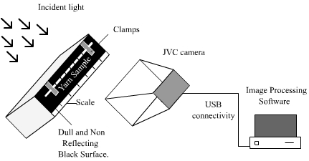
Proposed hardware design

Slide 11
Image analysis
1”
Yarn image of 1 inch length taken by a sensitive camera in presence of a predefined illumination setup. The background was set to black to evident more details of yarn structure during imaging.

Slide 12
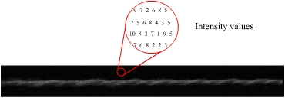
Background adjustment

Slide 13
Intensity adjustment of image
IMADJUST
The intensity of digital image of yarn is adjusted in order to evident the minute
details more clearly.

Slide 14
Image cropping and pattern recognition
Phenomenon of alternating color intensities visualized in gray scale image of yarn present in yarn texture due to irregular reflection of light. Based on these bright and dark clusters in the yarn body there is a certain pattern can be observed that repeats itself after a specified number of pixels.

Slide 15
Graph between pixel intensity and number of pixels
Graph: Relation between intensity values of pixels and no. of pixels

Slide 16
ROI filtering on basis of pixel intensity
ROIFILT
Figure: Region of interest filtering on basis of intensity values
NFILTER
Figure: Implementation of neighborhood processing to precise the results

Slide 17
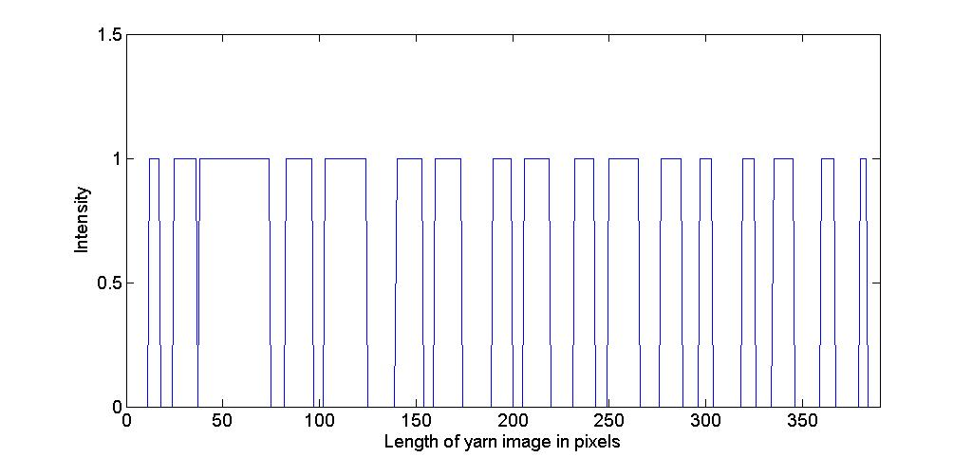
Binary pixels graph
Figure: Identifiable dark and bright places in binary image of cropped area
BWLABEL

Slide 18
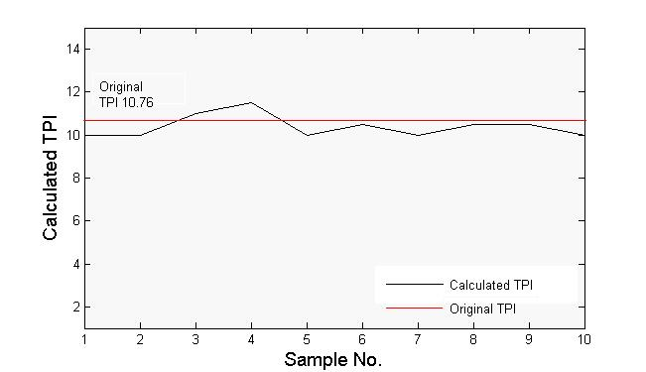
Results for 8 double yarns
Sample No. | Calculated TPI
1 | 10
2 | 10
3 | 11
4 | 11.5
5 | 10
6 | 10.5
7 | 10
8 | 10.5
9 | 10.5
10 | 10
Mean Calculated Twist = 10.4 Standard Deviation = 0.516
Actual Twist = 10.76 CV %age = 4.96%

Slide 19
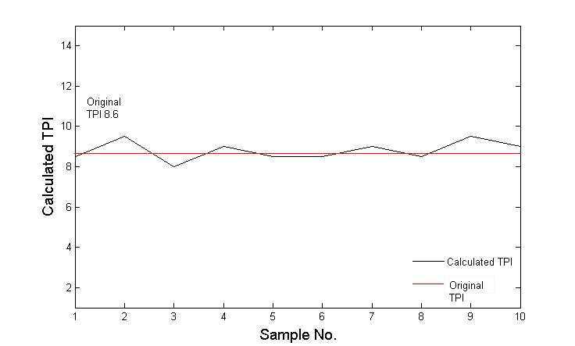
Results for 10 doubled yarns
Sample No. | Calculated TPI
1 | 8.5
2 | 9.5
3 | 8
4 | 9
5 | 8.5
6 | 8.5
7 | 9
8 | 8.5
9 | 9.5
10 | 9
Mean Calculated Twist = 8.8 Standard Deviation = 0.483
Actual TPI = 8.6 CV %age = 5.49%

Slide 20
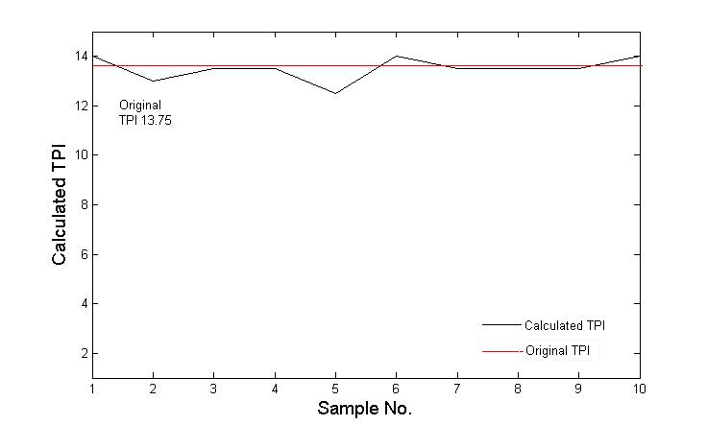
Results for 15 double yarns
Sample No. | Calculated TPI
1 | 14
2 | 13
3 | 13.5
4 | 13.5
5 | 12.5
6 | 14
7 | 13.5
8 | 13.5
9 | 13.5
10 | 14
Mean Calculated Twist = 13.5 Standard Deviation = 0.471
Actual Twist = 13.75 CV %age = 3.49%

Slide 21
Conclusion
As it is clear from the above calculated values of TPI, comparison of reference values and calculated values, standard deviation from mean value and CV %age of TPI calculated, the image processing technique can be used in the determination of twist per inch values of doubled yarns on commercial level. Although there are variations from the average value and also there are limitations in this image processing algorithm but these variations can be fixed with more precise hardware setup and fine tuned IP algorithm. That means a combination of simple setup of hardware and user friendly software can eliminate the conventional testing techniques and their drawbacks for measurement of TPI values of yarn. This investigation has opened a new horizon for researchers to make this technique usable on the professional grounds to test TPI values of yarn without application of mechanical factors and to enter the era of non destructive and online testing.

Slide 22
References
Adams, R. (September, 1993). ‘Radial Decomposition of Discs and Spheres’ Computer
Vision, Graphics, and Image Processing: Graphical Models and Image Processing, Vol. 55, No. 5, pp. 325-332.
Cybulska, M. (1999). ‘Assessing Yarn Structure with Image Analysis Methods 1’,
Textile Res J. 69(5), 369-373.
Savialle, B. P. (1999). Physical testing of textiles. (pp. 85-94). England: Woodhead Publishing
Ltd.
Schwarz, E.R. (1938). ‘Twist Measurements in Single Yarns’, Textile Res. J. 8,
157-164.
Young, H. D., & Freedman, R.A. (2000). University Physics with Modern Physics (10th ed.).
USA: Addison-Wesley Publishing Company.
Matlab image processing toolbox online Documentation. Retrieved May 16, 2008, from
http://www.mathworks.com/access/helpdesk/help/toolbox/images

Slide 23
Thank you very much for your kind attention

