Slide 1


Slide 2
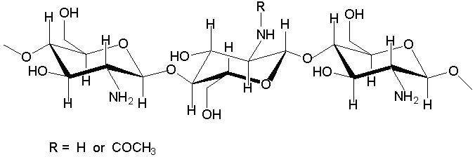

Effect of Combinability of Chitosan and PVA (Poly Vinyl Acetate) to Improve Soil Release Durability of Stiff Table Linen
3rd International conference
On textile and clothing
Mr. Nadir Ali Rind
Presenter
By UMT, Lahore
Notes:
2

Slide 3
Authors
Mr. Nadir Ali Rind
Lecturer
Mehran University of Engineering and Technology, Jamshoro
Mr. Zeeshan Khatri
Lecturer
Mehran University of Engineering and Technology, Jamshoro
Dr. Muhammad Hanif Memon
Chief Associate
TEXCON: Textile Consulting Services, Karachi

Slide 4
Today’s Presentation
Introduction
Research Objectives
Experimental Work
Results and Discussion
Conclusion
References

Slide 5
Introduction

Slide 6


Market potential
Institutional Fabric
Table Linen (includes table cloth and table napkins)
American and UK market
ELREN (USA)
HILDEN (UK)
Demand
Stiff fabric
Soil release durability (Multiple washes)
PES/CO blend
Medium to heavy weight fabric (Damskas, Crepe/Mommy)
Adequate whiteness index more than or equal to 65

Slide 7
Early work
Early work indicated the use of PVA as stiffener together with flourocarbon-based soil release finish.
PVA deteriorates soil release property after multiple washing; hence the finishing was not durable.
This remain a problem in industry, PVA withstand only upto 3 washes.
The research work was needed to improve durability of soil release of such fabrics.

Slide 8
This Research work
This research was aimed to achieve stiffness and durable soil release finish to table linen textile composed of CVC Polyester/ Cotton blend using Chitosan.
The present process consists of simple pad-dry-cure method which was optimized. The prime focus of using Chitosan was to get stiff textile with durable soil release characteristics.
To improve stiffness and durability, Chitosan is used with PVA and soil release agent (fluoro carbon based) at reduced quantities.
The Soil release tests were conducted on treated samples and compared to control. The commecially required stiffness with a durable soil release finish has been achieved.

Slide 9
Research Objectives

Slide 10
Therefore, the main objectives of this research work were:
To get stiff textile characteristics.
To get durable soil release characteristics.

Slide 11
Experimental Work

Slide 12
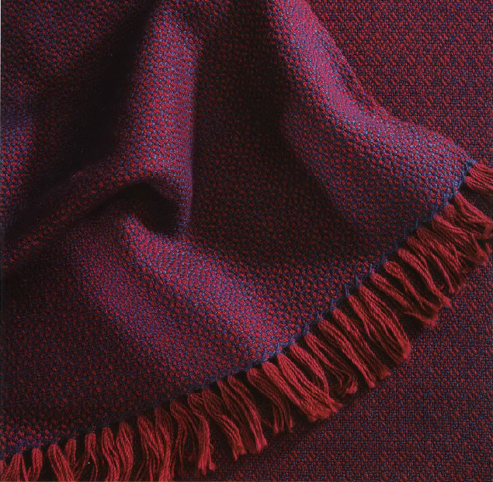
Material
Crepe fabric (Mommy fabric)
GSM = 194.8
pH = 7
Picks/inch = 68
Ends/inch = 56
degree of whiteness=74-76
Chemicals
Chitosan
Poly Vinyl Acetate (PVA)
Nuva SRB

Slide 13
Chitosan
Chitosan is an effective natural antimicrobial agent derived from Chitin, a major component in crustacean shells.
Chitosan applied to textiles has been widely studied for effects such as: [1]
  Stiffener
  Shrink resistance
  Improved dye uptake and
  As auxiliary or anti-static agents, etc.
It is a cationic in nature
It is readily soluble in dilute acids between pH 4-5
Chitosan- 85% De-acetylated- Marine Chemicals, India
Physical appearance of Chitosan is off-white and is odorless.
In textile industry, chitosan is used in pretreatment and finishing processes of textiles [2-5]

Slide 14
Soil release agent
Fluro carbon based- Nuva SRB Clariant
Soil-release finishing for textiles is to facilitate the removal of soiling matter during laundering
Physical appearance of Nuva-SRB is milky white
Ionic character of Nuva-SRB is cationic
PH of NUVA-SRB is 6
Mechanism of soil release based on;
Adsorption of detergent and absorption of water
Mechanical work [6-9]
© 2010
Notes:
14

Slide 15
Poly Vinyl Acetate (PVA)
APPRETAN-CTM Clariant
Nature: Poly (vinyl acetate)-thermoplastic polymer obtained by polymerization of vinyl acetate
Appearance: It is white and non-ionic in nature.
Solubility: In 10% solution the solubility of Appretan-CTM is good and also PH of 10% solution is 5-5.5
Stiffness: Polyvinyl acetate has a glass transition temperature of 30 °C and provides a stiff hand to treated fabrics [10-11]
Softness: It softens at temperatures above 40-50 °C
Notes:
15

Slide 16
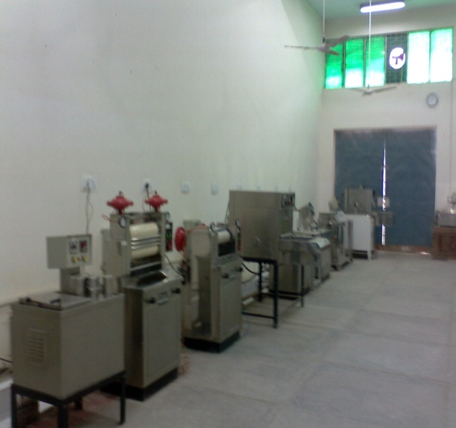
Wet Processing Lab
Department of Textile Engineering
MUET, Jamshoro
Methods
Pad →Dry →Cure
Pad: 70%
Dry: 120 Degree Celsius for 3 minutes
Cure: 150 Degree Celsius for 5 minutes

Slide 17
Fabric Testing:
  AATCC Test Method 130-2000:
  Soil release: Oily stain release method.
  Cantilever Method ASTM D-1388-96:
  Fabric stiffness and drape qualities can be easily quantified by this method.

Slide 18
Results and Discussion

Slide 19
Effect of combinability of PVA and NUVA SRB on soil release

Slide 20
Effect of combinability of PVA and NUVA SRB on soil release

Slide 21
Effect of combinability of PVA and NUVA SRB on soil release

Slide 22
Effect of combinability of PVA and NUVA SRB on soil release

Slide 23
  Effect of combinability of PVA, Chitosan and NUVA SRB on soil release

Slide 24
Effect of combinability of PVA and NUVA SRB on Stiffness

Slide 25
  Effect of combinability of Chitosan, PVA and NUVA SRB on Stiffness

Slide 26
  Comparison between with and without Chitosan on fabric soil release

Slide 27
  Comparison between with and without Chitosan on fabric Stiffness

Slide 28
Conclusion

Slide 29
Conclusion
The increased quantity of PVA adversely affects the soil release durability up to 10 washes.
The effect of combinability of Chitosan and PVA was studied to improve soil release durability of Stiff table linen.
The use of Chitosan combined with PVA and Nuva SRB showed a great potential in terms of improvement in soil release durability that was achieved up to 4/5 ratings.
Advantageously, the quantities of both PVA and Nuva SRB were reduced down to 50% in case of chitosan was used in combination. The required stiffness was also achieved.

Slide 30
References
Jon M.Einarsson, Singurour Hauksson, Johannes Gislasoon and Primex ehf
Martin G.Peter, Kristberg Kristbergsson, University of Iceland and The Icelandic fisheries laboratories, University of Potsdam, 2009
Yoldaş SEKİ, Faculty of Arts & Sciences (Chemistry Dep), URL: http://kisi.deu.edu.tr/yoldas, 2009.
www.teonline.com/knowledge-centre/chitin-chitosan.html retrieved on Oct 21, 2009.
I D Robb, Halliburton, Oklahoma, US, Aviary, Jc Johnsons, Eggmenton, UK, 2008
www.teonline.com/textile-chemicals, 2oo9
E Kissa, ‘Soil Release Finishes’, in Handbook of Fiber Science and technology, Vol. 2, ‘Chemical processing of fibers and fabrics, Part B Functional finishes’ (New York: Marcel Dekker, 1984) 211-289.

Slide 31
E Kissa, Text. Research J., 43 (1973) 86.
Cooke T F, ‘Soil release finishes for fibres and fabrics’, Textile Chemist and Colorist, 1987, 19(1), 31–41.
Pailthrope M and David S K, ‘Antistatic and soil release finishes’, in Textile Finishing, Heywood D (ed.), Bradford, Society of Dyers and Colourists, 2003, 330.
Polyvinyl Acetate (PVAc) (Vinyl Acetate Homopolymer) Report - Europe / European Adhesives Industry - RAW MATERIAL Market
Young, M.E., M. Murray and P. Cordiner (1999). "Stone consolidants and chemical treatments in Scotland". Rober Gordon University, Building Research Establishment and Historic Scotland.
http://www2.rgu.ac.uk/schools/mcrg/miconsol.htm. Retrieved on 2009-07

Slide 32
THANKS

Slide 33
Questions and
Comments

