Slide 1
Latest development in textile finishing
Faheem Uddin, Ph. D, C. Text. FTI
Professor, BUITEMS (Balochistan University of Information Technology, Engineering and Mamagement Science), Quetta.

Slide 2
What to talk in this presentation
Aims
Questioning latest development !
Global market in fiber - finishing consumption
The beauty of textile materials and finishing
The origin of textile chemical finishing
Guiding pillars in textile finishing
The development areas in textile finishing
How to identify the development areas
Some demanding areas in textile finishing.

Slide 3
Aims
An introduction to the recent advancement in textile chemical finishing
Emphasizing the relationship of development with local needs
Identifying the areas of interest for the latest development in textile finishing

Slide 4
Questioning latest development!
Few questions in latest development:
What are the latest development in textile finishing?
What should be the latest development in textile finishing?
Should the latest development in textile finishing should be stereotype in all around the world?

Slide 5
Figures in textile finishing development- I
The global market for fibres totalled 64 million tonnes in 2004 (moved up from 60 MT).
Synthetic fibres (40 MT), natural fibres (24 million tonnes). The breakdown is polyester (40%), cotton (36%), polypropylene/other olefins (7%), polyamide (6%), acrylic (4%), regenerated cellulosic fibres (4%) and wool (2%).
Main end-uses- apparel (65%), household textiles (18%) and technical textiles (17%)…….. (I. Holme)
World population and rising middle class demands more fibers and more value through finishing.
By 2009, the production of non- woven in Greater Europe reduces 6.3% to 1.6 MT.

Slide 6
Figures in textile finishing development- II
Softly the textile chemical auxiliaries sold are assumed to be 1/10th of global fiber production in one year, that stands to 6.4 MT.
Distribution to textile chemical auxiliaries: Finishing- 40%, Dyeing and printing- 20%, Pre-treatement- 17%, Weaving- 14%, Spinning-9%.
In special finishing, the major finishing products areas (by value) are softeners-20%, Repellant types- 15.2, Flame retardatns- 13.9, Durable press- 7.9%. ………(Schindler and Hauser)

Slide 7
The beauty of textile materials and finishing
The accelerated expansion in the utilization textiles materials is coming from the fascinated combination of properties offered:
Strength, softness, permeability, opacity, pliability, light weight, formability, modifiable.
All these together are not present in metals, plastic, paper, wood, concrete etc.
Textile finishing provides extensive opportunities to modify a given textile for a desired application.

Slide 8
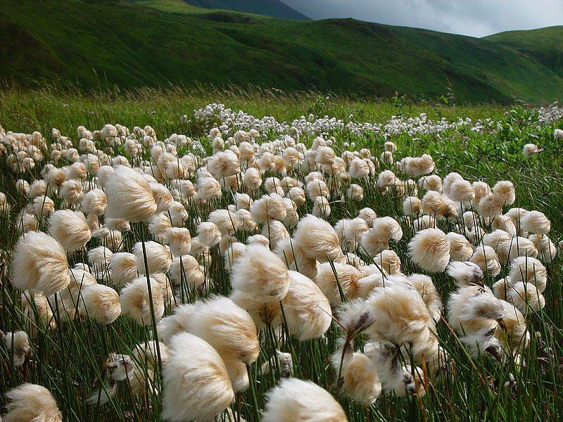
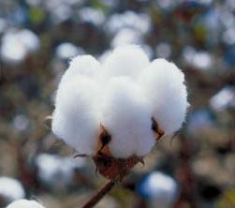
The chain of development in textile finishing…..I

Slide 9
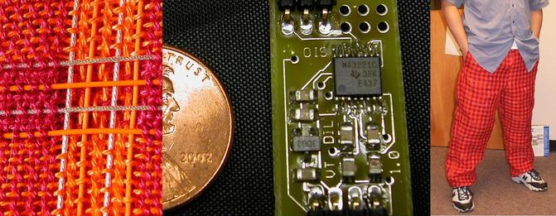
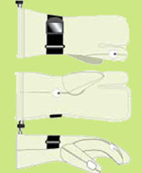
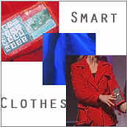
The chain of development in textile finishing…..II

Slide 10
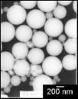
The chain of development in textile finishing…..III
1. Silica 2. Gold 3. Silver

Slide 11
Recent subjects in textile finishing
Most of the recent more advanced version of finishing development have origin in 1990’s.
Nanofinishing (why not microfinishing?)
Microencapsulation
Phase change materials
Plasma treatment
Application specific technical textiles
Composites structures
Non- aqeous or low water finishing
Biotechnology
Technical natural fibers; and biodegradble products!
Development in traditional finishing processing

Slide 12
Drivers in the development- I
Manufacturers and suppliers
Industrial processors
Research, development and innovation organizations
University researchers
Third party research providers
Environmental and funding agencies
Govt.- university- industry partnerships

Slide 13
Drivers in the development- II
Commercial forces are faster in introducing the development:
Waterless finishing CO2-The Yeh Group will be the first textile mill to implement the new waterless dyeing process developed by Dutch company DyeCoo Textile Systems.
Cornstarch solution in surgical garment and bullet proofing- Singapore researchers have invented a flexible, lightweight, impact-resistant composite material based on the same principles of how a cornstarch solution hardens on impact.
Leaving Silver and Gold- A composite medical dressing containing a metal oxide has been developed by two research centres in Taipei, Taiwan. According to the Medical and Pharmaceutical Industry Technology and Development Center and National Applied Research Laboratories, the metal oxide replaces the nanoparticles of silver or gold used in antimicrobial dressings.

Slide 14
Development ----III
Ropes made with Dyneema are proving a safe and secure alternative to steel wire rope for connecting barges and vessels in ‘push combinations’ working on inland waterways.
TenCate Grass has substantially expanded the production capacity of its most sustainable synthetic turf product, TenCate XP Blade. The start-up of an additional production line in Dayton, Tennessee, USA, will enable the company to meet the sharp increase in global demand for these wear-resistant synthetic turf fibres.
A new kind of implant made of titanium foam developed at the Fraunhofer Institute for Manufacturing and Advanced Materials (IFAM) resembles the inside of a bone in terms of its structural configuration. Not only does this make it less stiff than conventional massive implants, it also promotes ingrowth into surrounding bones.

Slide 15
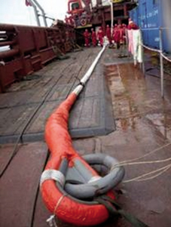
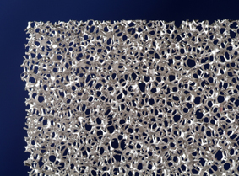

Slide 16
Drivers in the development- IV
Bone generation- A Stevens Institute of Technology scientist aims to establish a family of biomedical nanofibres containing collagen and calcium phosphate, to support the phenotype of bone forming cells.
BioSolar, the California-based developer of new technology to produce bio-based materials from renewable plant sources to reduce the cost of photovoltaic (PV) solar modules.
A flexible, honey-impregnated dressing for direct application to a wound has been developed for absorbing wound exudates by Api-Med Medical Honey, which is now part of Comvita New Zealand.

Slide 17
Medical and non- woven
Japan’s Daio Paper has established a joint venture with Thailand-based Saha Pathanapibul to produce baby diapers in Thailand. The US$36 million manufacturing facility in Chonburi province, the group’s first overseas plant, is planned to begin production in the first quarter of 2012. Initial monthly output is expected to be 16–18 million units, which could eventually be increased to 90–100 million units. Daio Paper owns 85% of the joint venture, which is called Elleair Interna; Saha Pathanapibul holds 10% and another Thai company, Sanko, has a 5% share.
A process for treating fibres to render them more hydrophilic has been developed by Procter & Gamble. The invention could find application in the production of nonwoven fabrics used to make disposable absorbent articles, such as baby diapers and adult incontinence garments.
The global medical nonwoven disposables market is forecast to exceed US$19 billion by 2015, according to a new report, spurred by such factors as robust growth in developing countries, rapid technological advancements in nonwovens manufacturing, and growing awareness about health and hygiene issues.

Slide 18
Drivers in the development- V
Nanotechnology developed by Vestagen Technical Textiles (USA) can help prevent the formation of potentially dangerous microorganisms on hospital and healthcare textiles, such as scrubs, uniforms, laboratory coats, privacy curtains and gowns.
The University of Wales, Newport, is launching the first MA (Master of Arts)/MFA (Master in Fine Arts) Smart Clothes and Wearable Technology courses in October.

Slide 19
Textile Nanofinishing- I
Nanosphere finish- from Clariant and Schoeller Technologies AG. Textile materials finished with Nanosphere repel liquids and dirt, and stains from kethch up; oil and red wine run off the surface.
‘Nano- Plem’ technology is claimed by Toray, Japan. This imparts water- repellant characteristics and color resilience to nylon and polyester fabrics, and Terylene/ wool blends.
Mincor TX TT, a nanofinish from BASF, is a composite material consisting of nanoparticles embedded in a carrier matrix. This finish may provide solution for the fabrics like polyester awning, sunshades, flags and sails that are generally required to remain continuously in outdoor environment; therefore these can not be cleaned in washing machine.
Synthetic fibers can be made soft and comfortable like cotton. Nano- TouchTM fabric technology is known to permanently graft an outer layer of cotton- like properties around a synthetic fiber core.

Slide 20
Textile Nanofinishing- II
Nanometals and nanometal oxide based finishes
Properties of metal nanoparticles and metal oxide nanoparticles to interact light and microorganisms have potential to offer substantial desired effects in textile materials. The subject is under exploration in textile and fiber finishing. Particular considerations are required to use the nanoparticles that are risk- free during their life cycle (production, application, consumption, and disposition).
Metal based nanofinishes Nanosilver particles can impart antimicrobial properties, and metal oxides may produce flame retardancy, UV blocking and self- cleaning properties.
Some of the known problems associated with the nanosilver are high cost, incompatibility to aqueous systems and tendency to cause discoloration in textiles.

Slide 21
Textile Nanofinishing- III
Metal oxide nanofinishes- Organic embedded metal oxide; ZnO nanoparticles, the average size was estimated to 38 ± 3 nm using TEM, dispersed into soluble starch matrix using water- based technique were investigated. The treated cotton fabric exhibited significant improvement in antibacterial activity against Staphylococcus aureus and Klebsiella pneumoniae cultures and UV radiation. For clothing textiles a concentration of nano- ZnO of 0.6 wt. % for UV protection, and for antimicrobial textiles 1.0 wt. % concentration were recommended.
Nanograde TiO2 was included during the melt extrusion of nylon 6.6 to study the mechanical properties. In an exposure to artificial day light up to 750 hours; TiO2- nylon composite fibers exhibited increased resistance against photo- tendering.
Capability to enhance the UV protection of treated nylon 6.6 and Kevlar fabrics at 5 wt. % of TiO2 nanoparticles dispersed in acrylate and ethanol was observed. Similar effect was also seen in nylon 6.
Biological protective textiles can be produced using nanoparticle form of TiO2 and MgO.

Slide 22
Microencapsulation finishes potential areas
Thermoregulation (PCM)
Aromatherapy, fragrance release
Deodorising finishes, biocides
Antisoiling agents
Insect resisting finishing
UV abosrbers, antistatic agents,
FR, water repellants
Cross- linking agents, softeners, chemical protection, etc., etc.,

Slide 23
Clay finishing
Polymers reinforced with 2-5 wt% of nanoclays may exhibit significant improvement in thermal- mechanical properties, flame retardancy, barrier properties, dimensional stability, and modified electrical conductivity.
An interesting example is seem in nylon-6 nanocomposite reinforced with 5 wt % of nanoclay resulting in 40% increase in tensile strength, 68% in tensile modulus, 60% in flexural strength, and 126% flexural modulus. The heat distortion temperature increases from 65 0C to 152 0C.
Improving the tensile properties and fire performance of polypropylene thermoplastics using functionalized nanoclays had received significant research interest, however in the form of fiber, filament or fabric, this polymer had received little or no attention. In general, the literature on flame retardant finishing of textile fabrics using nanoclays is not significant.
Montmorillonite is one type of clay minerals mainly used in producing nanoclay- based finishes.
The commercial viability of nanoclays is mainly credited to their reduced cost (around US $ 2.25- US $ 3.25 per pound), wider applicability to most synthetic polymers (PP, TPO, PET, PE, PS, polyamide), and performance enhancement produced in end- product.

Slide 24
Questioning the latest development!- I
What should be the latest development!
Should be the development all around the world same!
The principal drivers of research, development and innovation are:
Society, Common people development
Environment
Industry

Slide 25
Questioning the latest development!- II
Local waste utilization
Natural waste utilization
More natural material development
Reduced energy and utility consumption through modified finishing processes.
Existing industrial processing technologies
Industry is more prompt to adopt the development in existing process technology than to replace them.

Slide 26
The end
Any comments
Contact details: Faheem Uddin, Ph. D, C. Text. FTI
Professor, BUITEMS, Quetta. Pakistan.
Emails. 1. dfudfuca@yahoo.ca ,
2. Faheem.Uddin@buitms.edu.pk
THANKS

